Slide 1
Object Tracking and Detection for Assisting Automated Identification of Surgical Instruments
Marcel Tenório Bezerra Academic Advisor: João Marcelo Teixeira
Technical Advisor: Jefferson Norberto
Recife - 2025

Slide 2
Surgical Instrument Management

Slide 3
Problem
Errors in instrument identification risk patient safety and increase operational costs.

Slide 4
Motivation
Automation improves reliability, complies with regulatory standards, and enhances efficiency.

Slide 5
Objective
Enhance an existing image recognition system by developing an automated surgical instrument tracking and detection.

Slide 6
Key Contributions
Real-time evaluation of video frames using a State Machine orchestrating OpenCV methods.
Use of 3D-printed models for system validation.
Adaptability under varying illumination conditions.

Slide 7
Methodology Overview

Slide 8
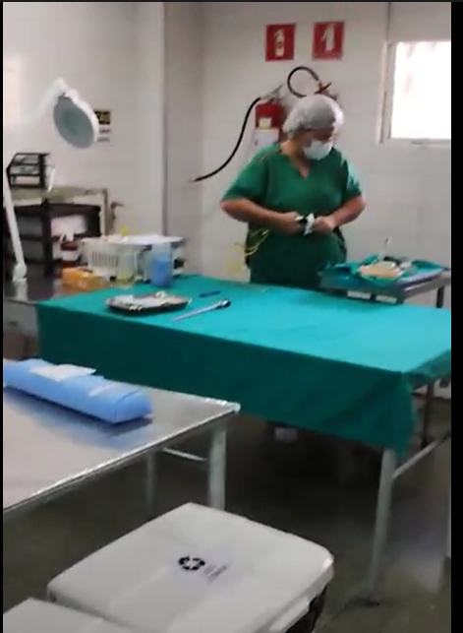
Application Scenario
Centro de Materiais e Esterilização - CME
Room with standard illumination levels (>750 lux)
Limited variable illumination expected (moving shadows)
Notes:
Central Server: Hosts the AI model, NVIDIA GPU-powered.
Edge Devices: Capture and preprocess video frames.
Network: High-speed infrastructure for data transmission.
Software: Python and OpenCV.

Slide 9
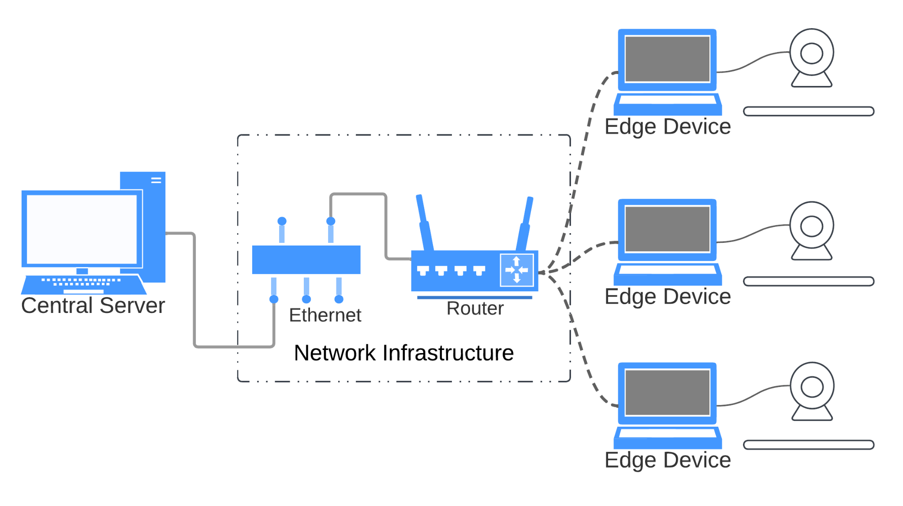
System Components
Notes:
Central Server: Hosts the AI model, NVIDIA GPU-powered.
Edge Devices: Capture and preprocess video frames.
Network: High-speed infrastructure for data transmission.
Software: Python and OpenCV.

Slide 10
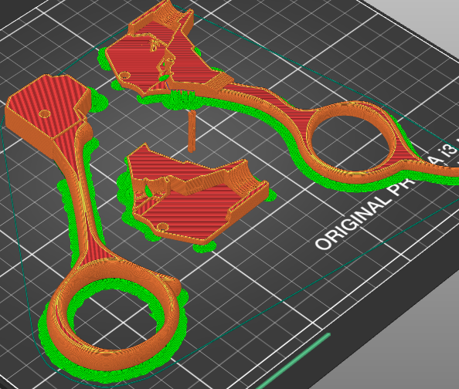
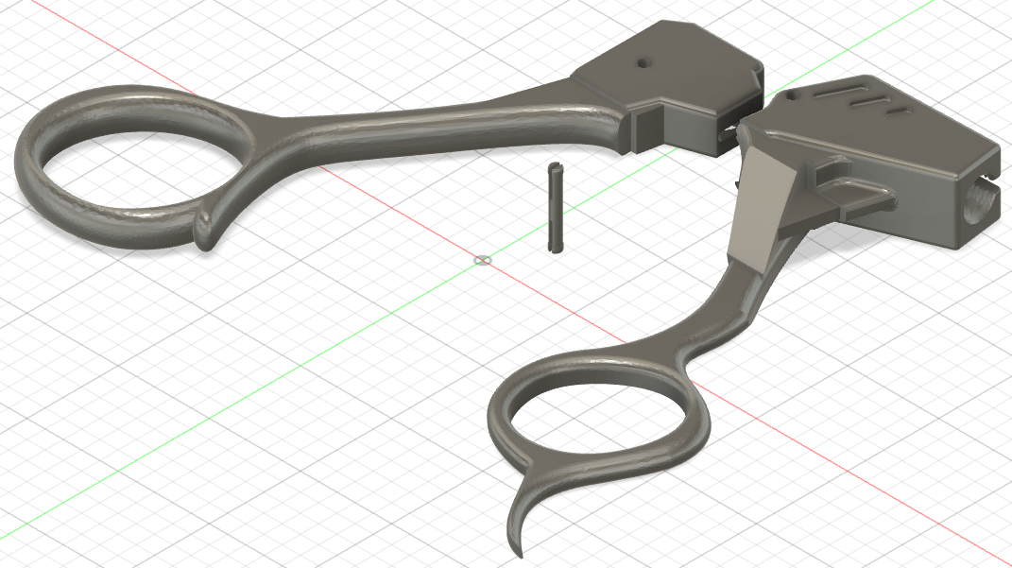
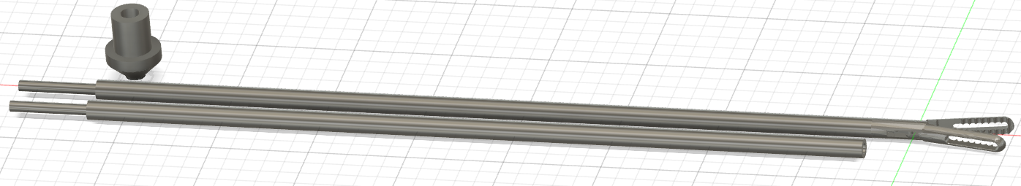
3D Printing and Experimental Setup
Notes:
Mock Instrument Creation
Measurements from CME visit.
Tools: Autodesk Fusion, Prusa Mk3S printer.
Painted PLA instruments for contrast testing.
Image: Show a 3D-printed instrument and experimental setup.

Slide 11
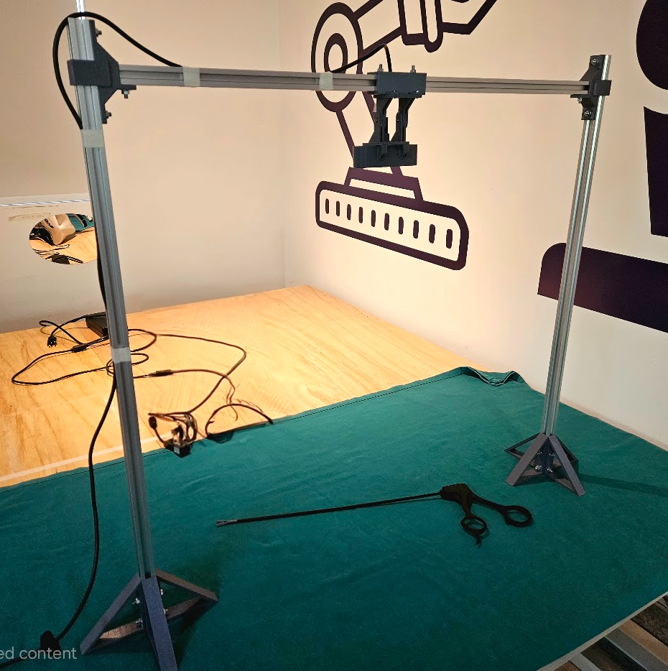
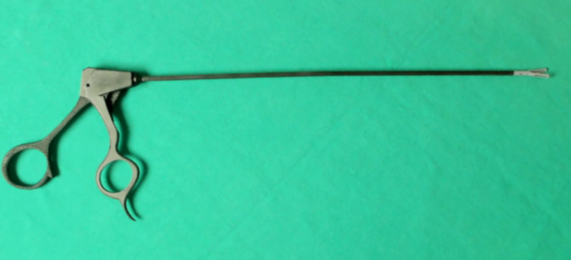
3D Printing and Experimental Setup
Notes:
Mock Instrument Creation
Measurements from CME visit.
Tools: Autodesk Fusion, Prusa Mk3S printer.
Painted PLA instruments for contrast testing.
Image: Show a 3D-printed instrument and experimental setup.

Slide 12
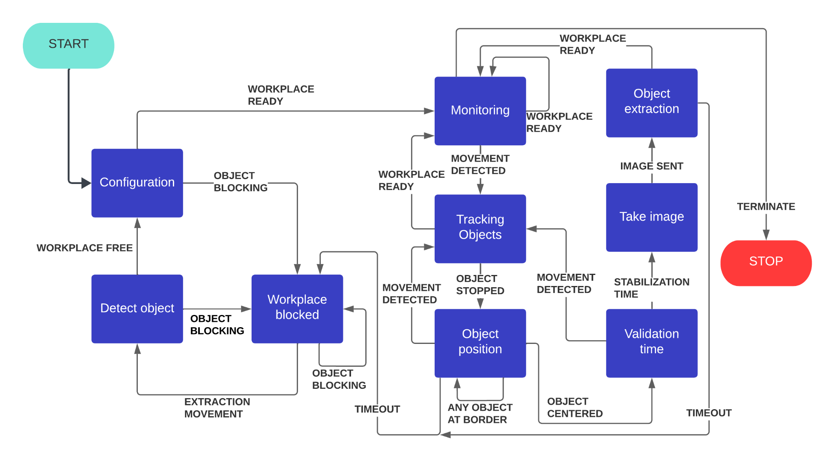
State Machine Workflow
Notes:
10 States: Monitoring, Tracking, Validation, Image Capture, etc.
Transitions: Ensures high-quality image acquisition.
Diagram: Include a simplified state machine flowchart.

Slide 13
State Machine Workflow
Notes:
10 States: Monitoring, Tracking, Validation, Image Capture, etc.
Transitions: Ensures high-quality image acquisition.
Diagram: Include a simplified state machine flowchart.

Slide 14
State Machine Workflow
Notes:
10 States: Monitoring, Tracking, Validation, Image Capture, etc.
Transitions: Ensures high-quality image acquisition.
Diagram: Include a simplified state machine flowchart.

Slide 15
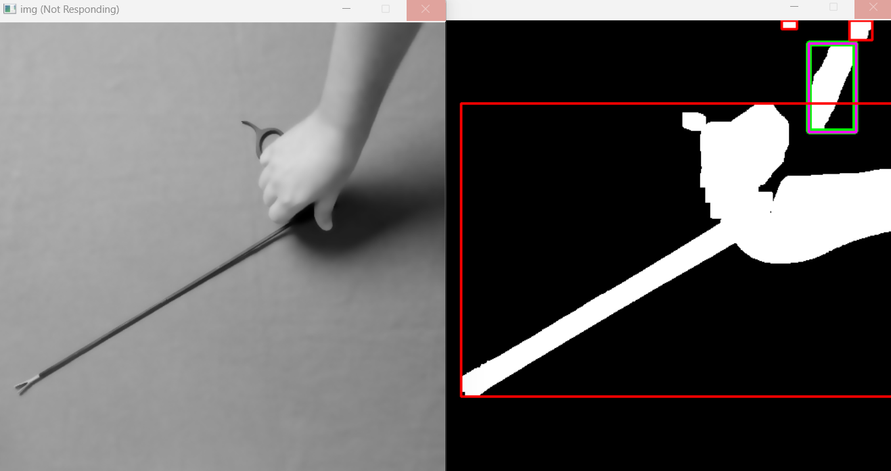

Image Processing Techniques
Background Modelling
Bounding box and Background Subtraction
Notes:
Background Subtraction (MOG2 algorithm).
Noise Reduction (Bilateral filter).
Contour Detection and Bounding Box.
Morphological Operations (Dilation).
Image: Show examples of processed images.

Slide 16
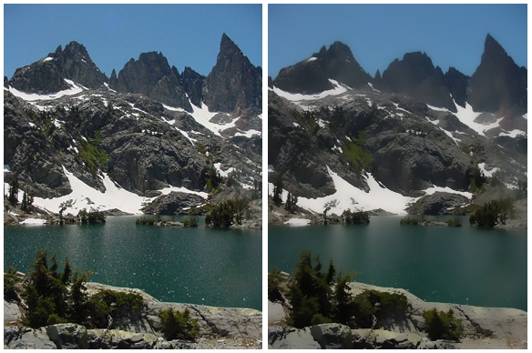

Image Processing Techniques
Dilation. By OpenCV https://docs.opencv.org/3.4/db/df6/tutorial_erosion_dilatation.html
Bilateral Filter Example. By U.S. National Park Service / Phrood - File:MinaretLake.jpg, Public Domain, https://commons.wikimedia.org/w/index.php?curid=27849862
Notes:
Background Subtraction (MOG2 algorithm).
Noise Reduction (Bilateral filter).
Contour Detection and Bounding Box.
Morphological Operations (Dilation).
Image: Show examples of processed images.

Slide 17
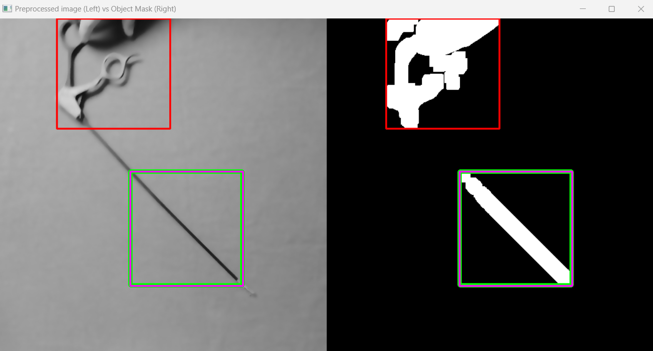
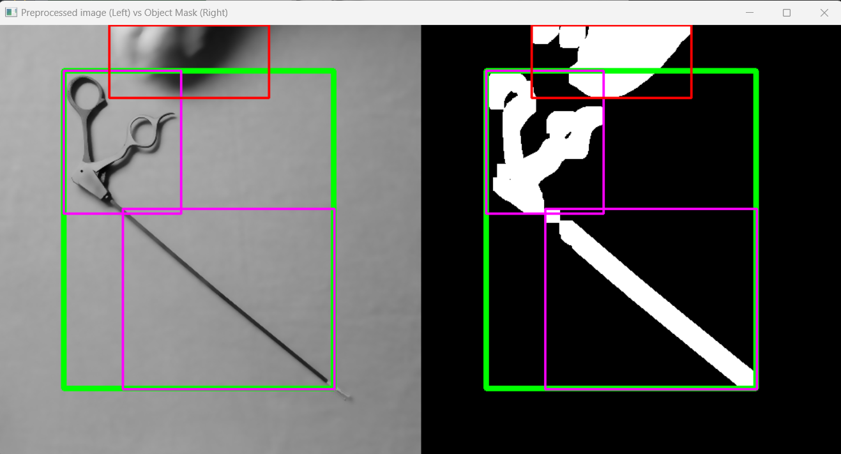
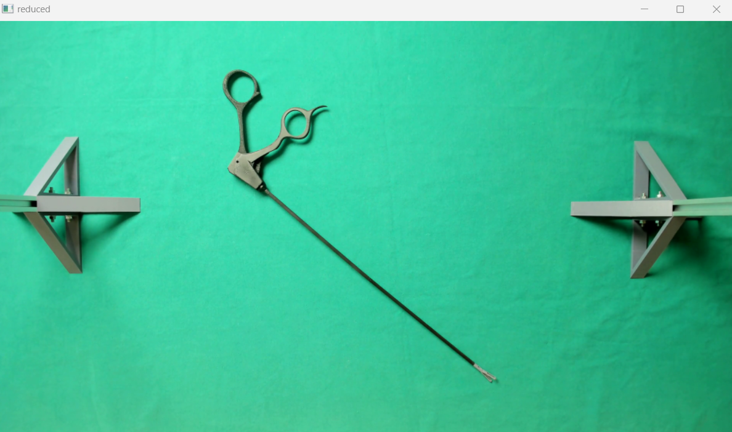
Results
Initial monitoring
Alignment Verification
Movement detection
Final Image Capture
Notes:
Stages:
Initial monitoring.
Movement detection.
Alignment verification.
Final image capture.
Images: Side-by-side examples of intermediate states.

Slide 18
Performance Metrics
Robustness: Operates under limited variable illumination (light shadows).
Efficiency: Optimized frame transmission to Central Server
(1 frame transmitted vs 10s video @ 30fps per object)

Slide 19
Conclusion
Developed an adaptable system for automated surgical instrument detection.
Validated performance under controlled light conditions.
Potential applications in broader fields, such as inventory management.

Slide 20
Future Work
Integration with CME’s image recognition project.
Adaptation for IoT and mobile platforms.
Broader testing across diverse instruments and real-world scenarios.

Slide 21
?
Questions

Slide 22
Obrigado pela atenção!

Slide 23
Título
Subtítulo

Slide 24
Cabeçalho de seção

Slide 25
Transição de seção

Slide 26
Conteúdo
Exemplo de texto

Slide 27
Título
Tópicos
Tópico 1
subtopic 1
Tópico 2
Tópico 3
Exemplo texto
T1
T2
T3

Slide 28
Somente título

Slide 29
Título
Exemplo texto

Slide 30
T1
texto
subtitulo

Slide 31
Comentário

Slide 32
NN
exemplo de texto

